Slide 1
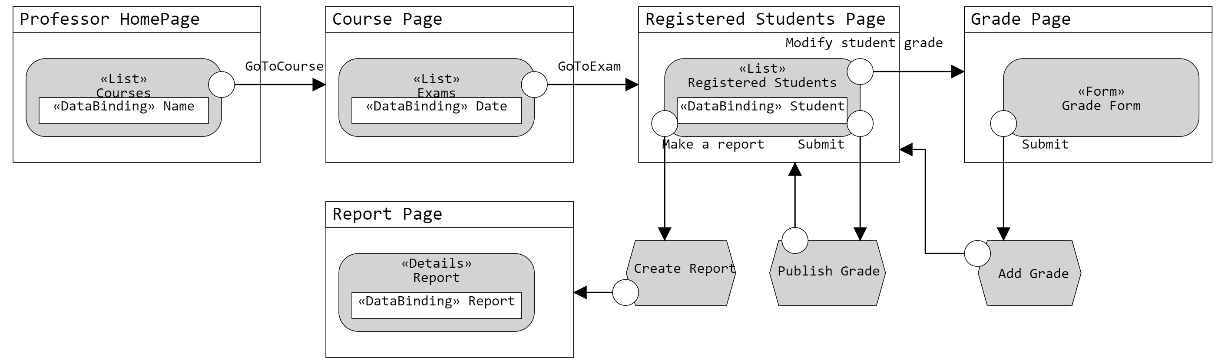
Application Design (Professor)
Student | Student_ID | Surname | Name | Email | School | Grade | Grade_State
Grade_State | Not_Inserted | Inserted | Published | Refused | Reported
Grade Form | Student_ID | Surname | Name | Email | School | Grade
Report | Report_ID | Date | Time | Exam_ID | Reported_Student
Reported_Student | Student_ID | Surname | Name | Grade

